Slide 1

DC Circuits
Series-Parallel Circuits
By Dr. Ahmed S. Abdullah
د. احمد سليمان عبدالله

Slide 2
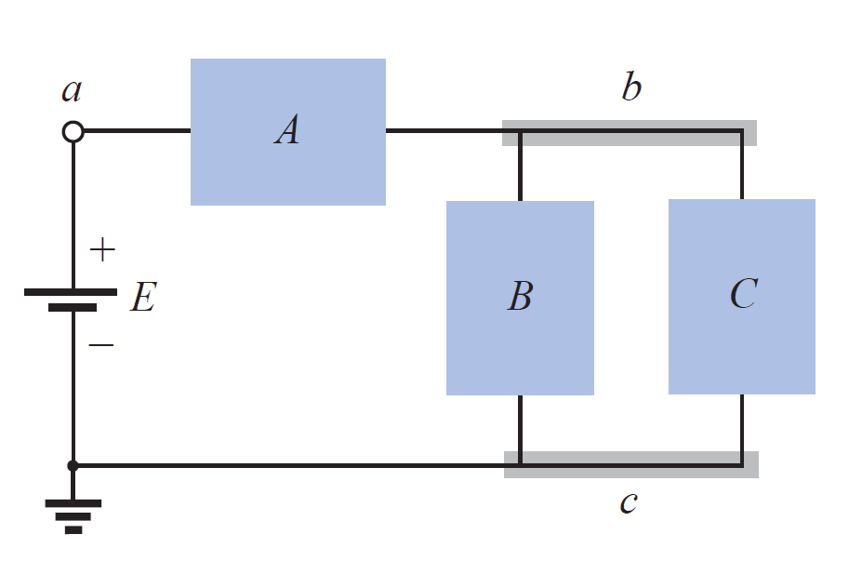
Series-Parallel Circuits
Series-parallel networks are networks that contain both series and parallel circuit configurations.
For many single-source, series-parallel networks, the analysis is one that works back to the source, determines the source current, and then finds its way to the desired unknown.
In Figure, blocks B and C are in parallel (points b and c in common), and the voltage source E is in series with block A (point a in common). The parallel combination of B and C is also in series with A and the voltage source E due to the common points b and c, respectively.

Slide 3
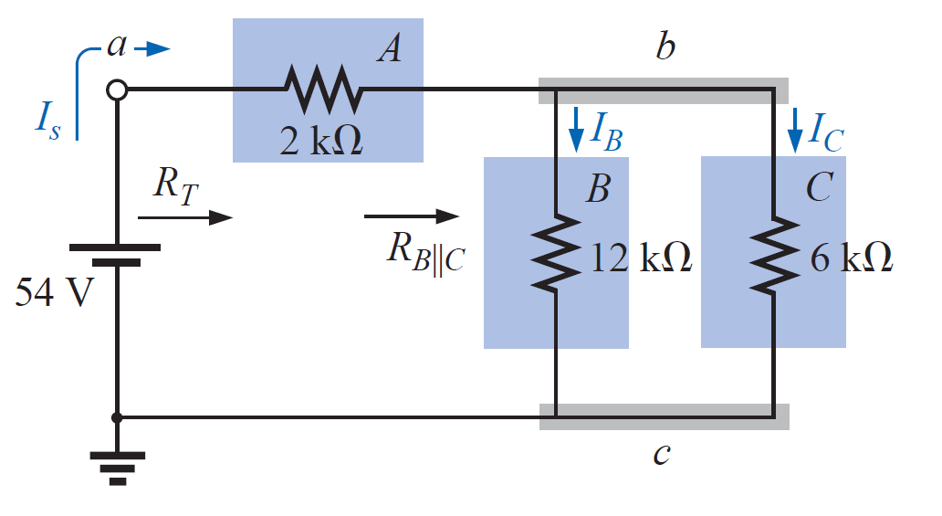
Series-Parallel Circuits
We can find the equivalent network
The parallel combination of RB and RC results in

Slide 4
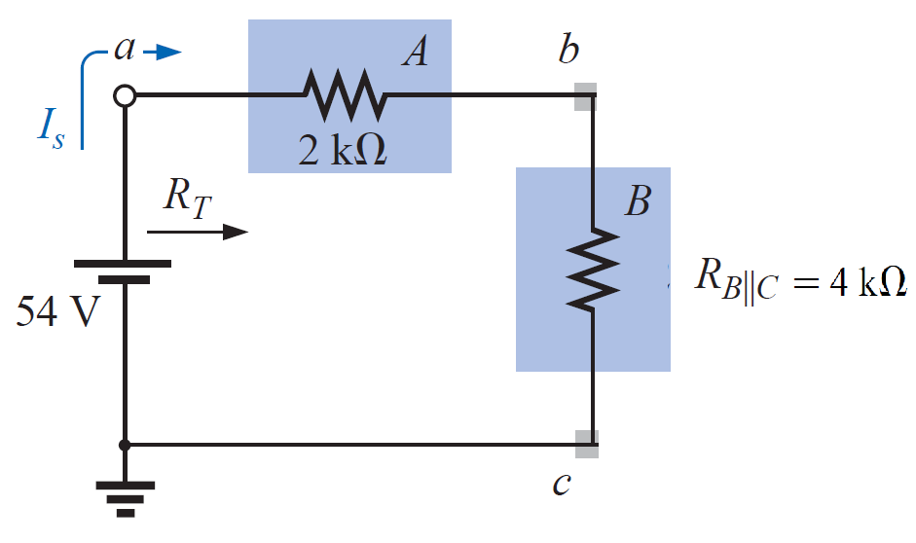
Series-Parallel Circuits
We can find the equivalent network
The parallel combination of RB and RC results in
C

Slide 5
Series-Parallel Circuits
We can find the equivalent network
The parallel combination of RB and RC results in
The equivalent resistance RBC is then in series with RA ,
and the total resistance is
C

Slide 6
Series-Parallel Circuits
We can find the equivalent network
The parallel combination of RB and RC results in
The equivalent resistance RBC is then in series with RA ,
and the total resistance is
The result is an equivalent network permitting the determination of the source current Is.
C

Slide 7
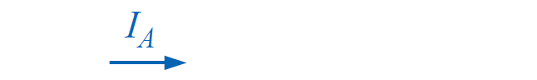
Series-Parallel Circuits
We can find the equivalent network
The parallel combination of RB and RC results in
The equivalent resistance RBC is then in series with RA , and the total resistance is
The result is an equivalent network permitting the determination of the source current Is.
C
and, since the source and RA are in series,

Slide 8
Series-Parallel Circuits
We can then use the equivalent circuit to determine IB and IC using the current divider rule:

Slide 9
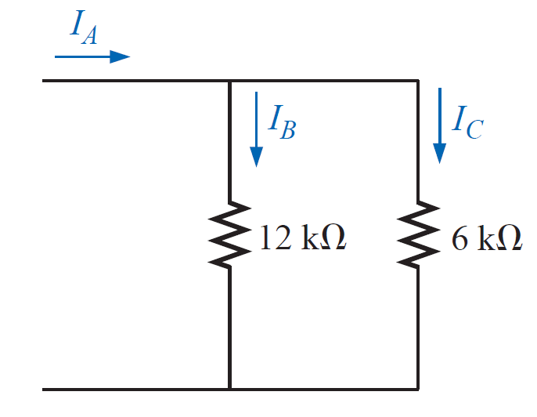
Series-Parallel Circuits
We can then use the equivalent circuit to determine IB and IC using the current divider rule:
or, applying Kirchhoff’s current law,

Slide 10
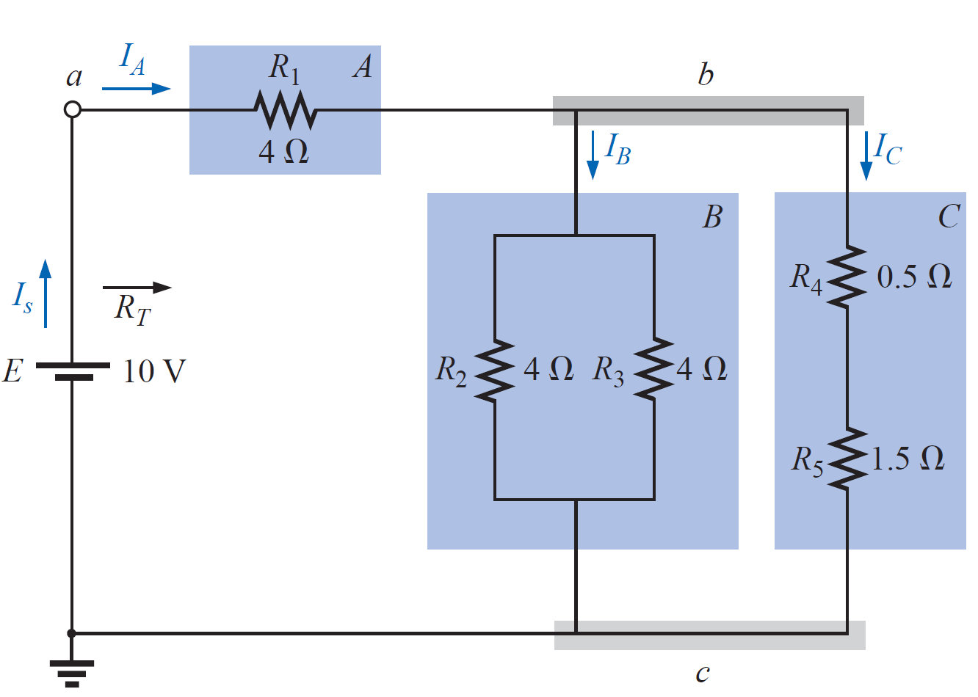

Series-Parallel Circuits
EXAMPLE For the circuit of Figure shown, determine the following quantities:
$$R_{T},I_{s},I_{A},I_{B},I_{C},V_{A},V_{B},and V_{C}$$

Slide 11
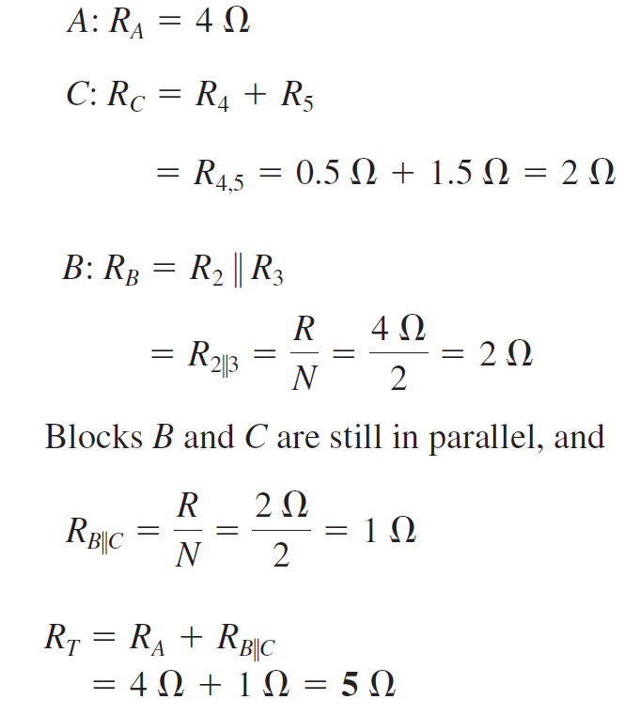
Series-Parallel Circuits
EXAMPLE For the circuit of Figure shown, determine the following quantities:
$$R_{T},I_{s},I_{A},I_{B},I_{C},V_{A},V_{B},and V_{C}$$

Slide 12
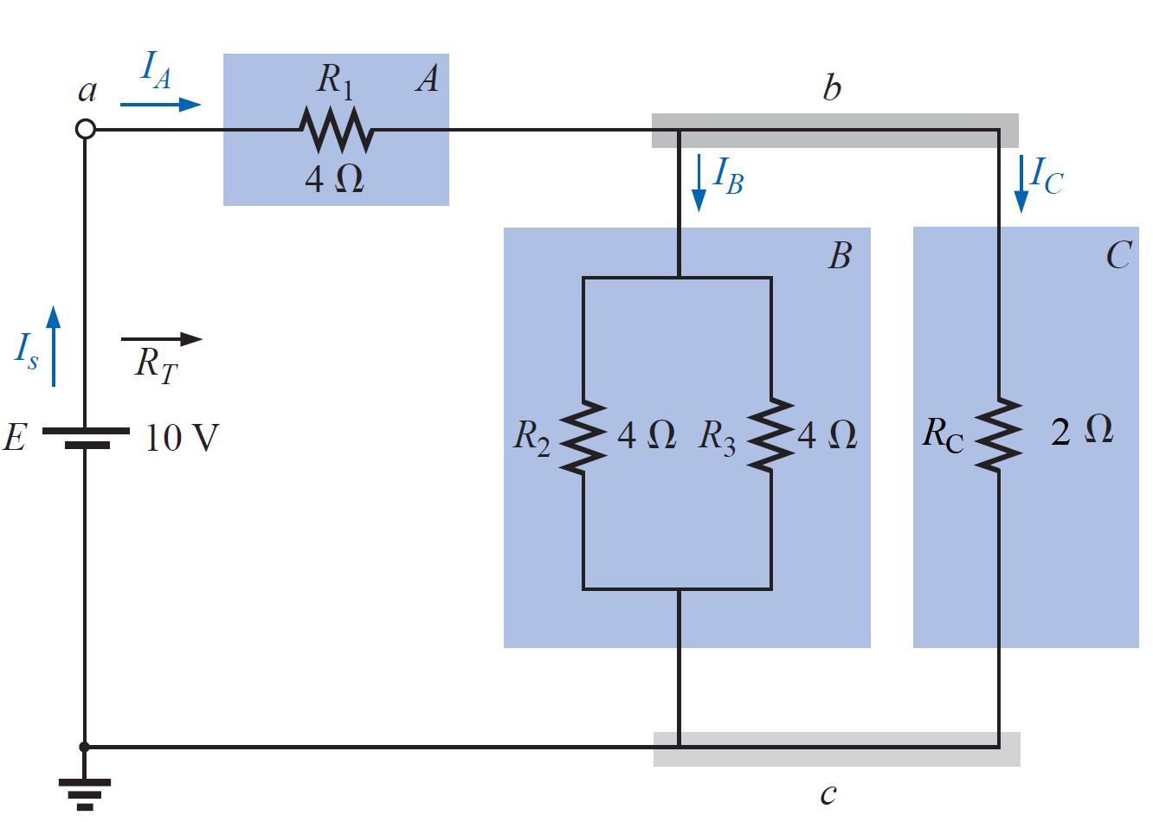
Series-Parallel Circuits
EXAMPLE For the circuit of Figure shown, determine the following quantities:
$$R_{T},I_{s},I_{A},I_{B},I_{C},V_{A},V_{B},and V_{C}$$

Slide 13
Series-Parallel Circuits
EXAMPLE For the circuit of Figure shown, determine the following quantities:
$$R_{T},I_{s},I_{A},I_{B},I_{C},V_{A},V_{B},and V_{C}$$

Slide 14
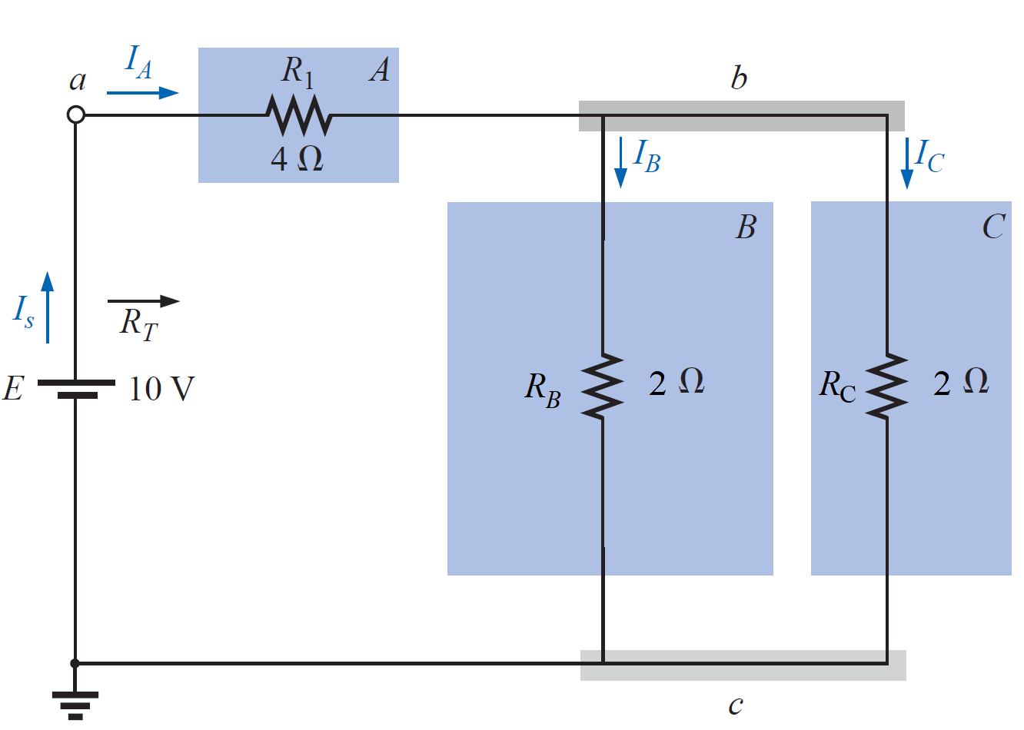
Series-Parallel Circuits
EXAMPLE For the circuit of Figure shown, determine the following quantities:
$$R_{T},I_{s},I_{A},I_{B},I_{C},V_{A},V_{B},and V_{C}$$

Slide 15
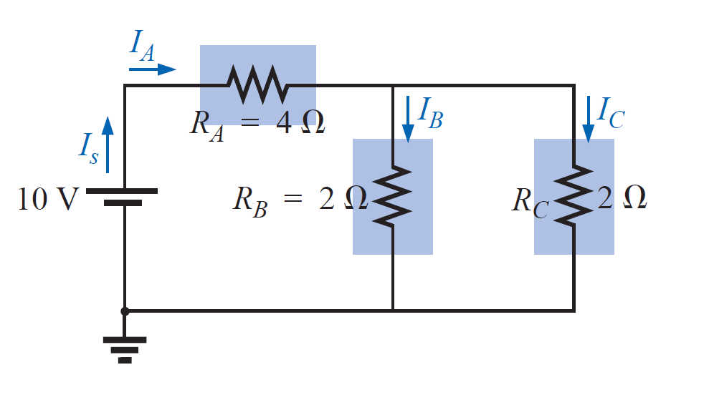
Series-Parallel Circuits

Slide 16
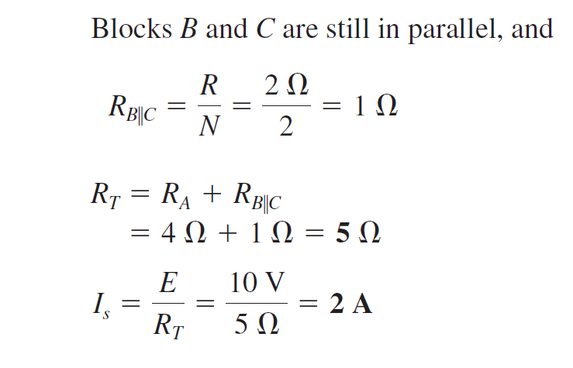
Series-Parallel Circuits

Slide 17
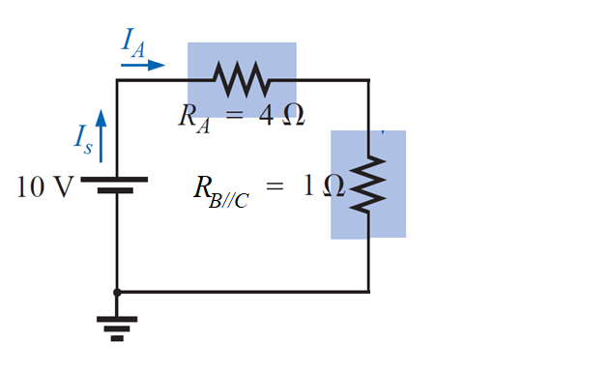
Series-Parallel Circuits

Slide 18
Series-Parallel Circuits

Slide 19
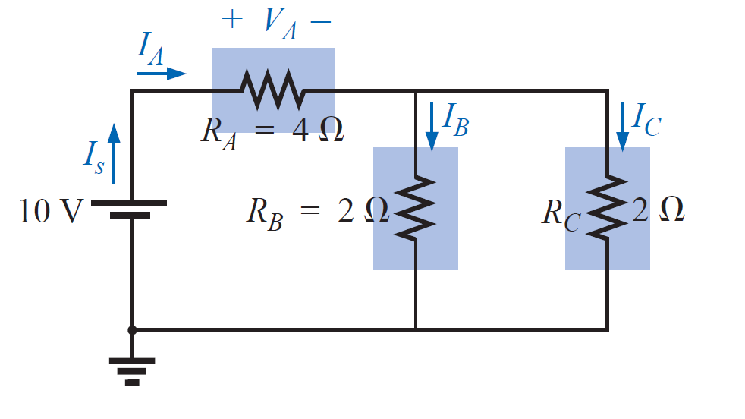
Series-Parallel Circuits

Slide 20
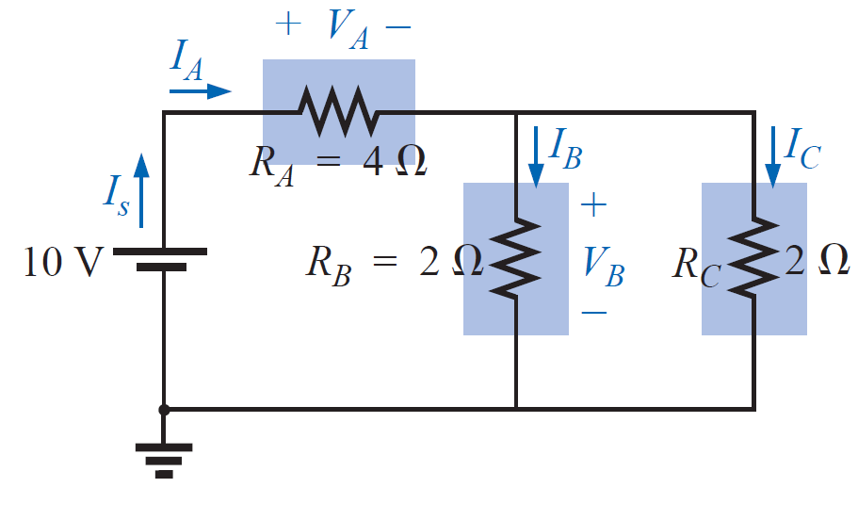
Series-Parallel Circuits

Slide 21
Series-Parallel Circuits

Slide 22
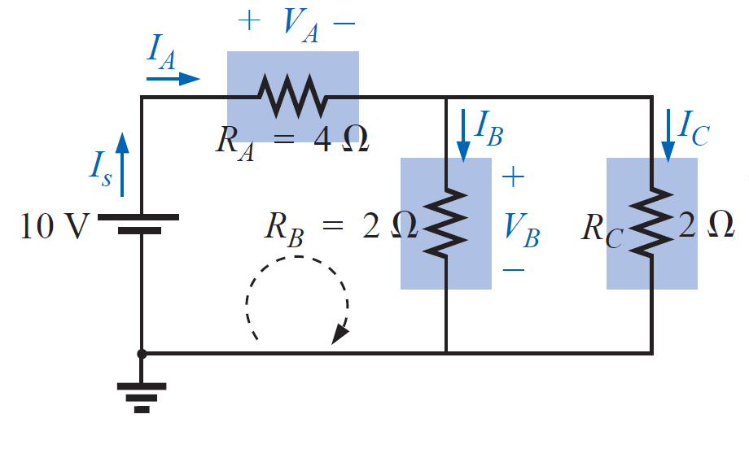
Series-Parallel Circuits
Applying Kirchhoff’s voltage law for the
loop indicated in Figure we obtain

Slide 23
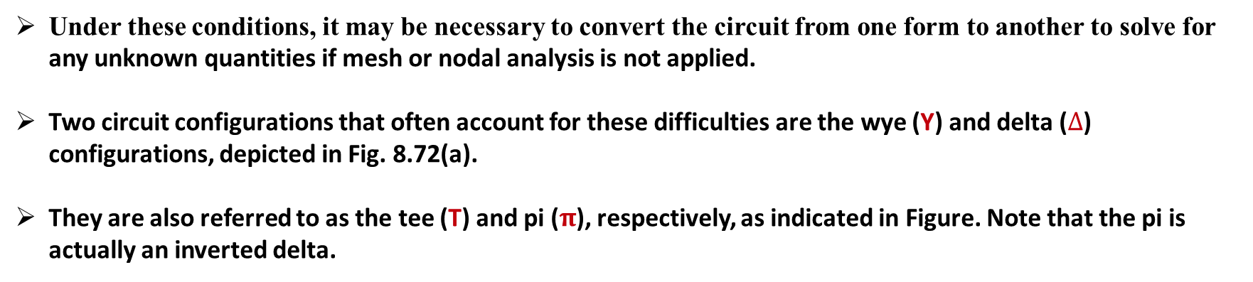
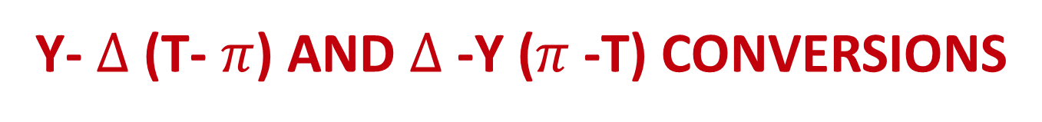
Y- $∆$ (T- $π$) AND $∆$ -Y ($π$ -T) CONVERSIONS
Circuit configurations are often encountered in which the resistors do not appear to be in series or parallel.
Under these conditions, it may be necessary to convert the circuit from one form to another to solve for any unknown quantities if mesh or nodal analysis is not applied.
Two circuit configurations that often account for these difficulties are the wye (Y) and delta ($∆$) configurations, depicted in Fig. 8.72(a).
They are also referred to as the tee (T) and pi ($π$), respectively, as indicated in Figure. Note that the pi is actually an inverted delta.

Slide 24
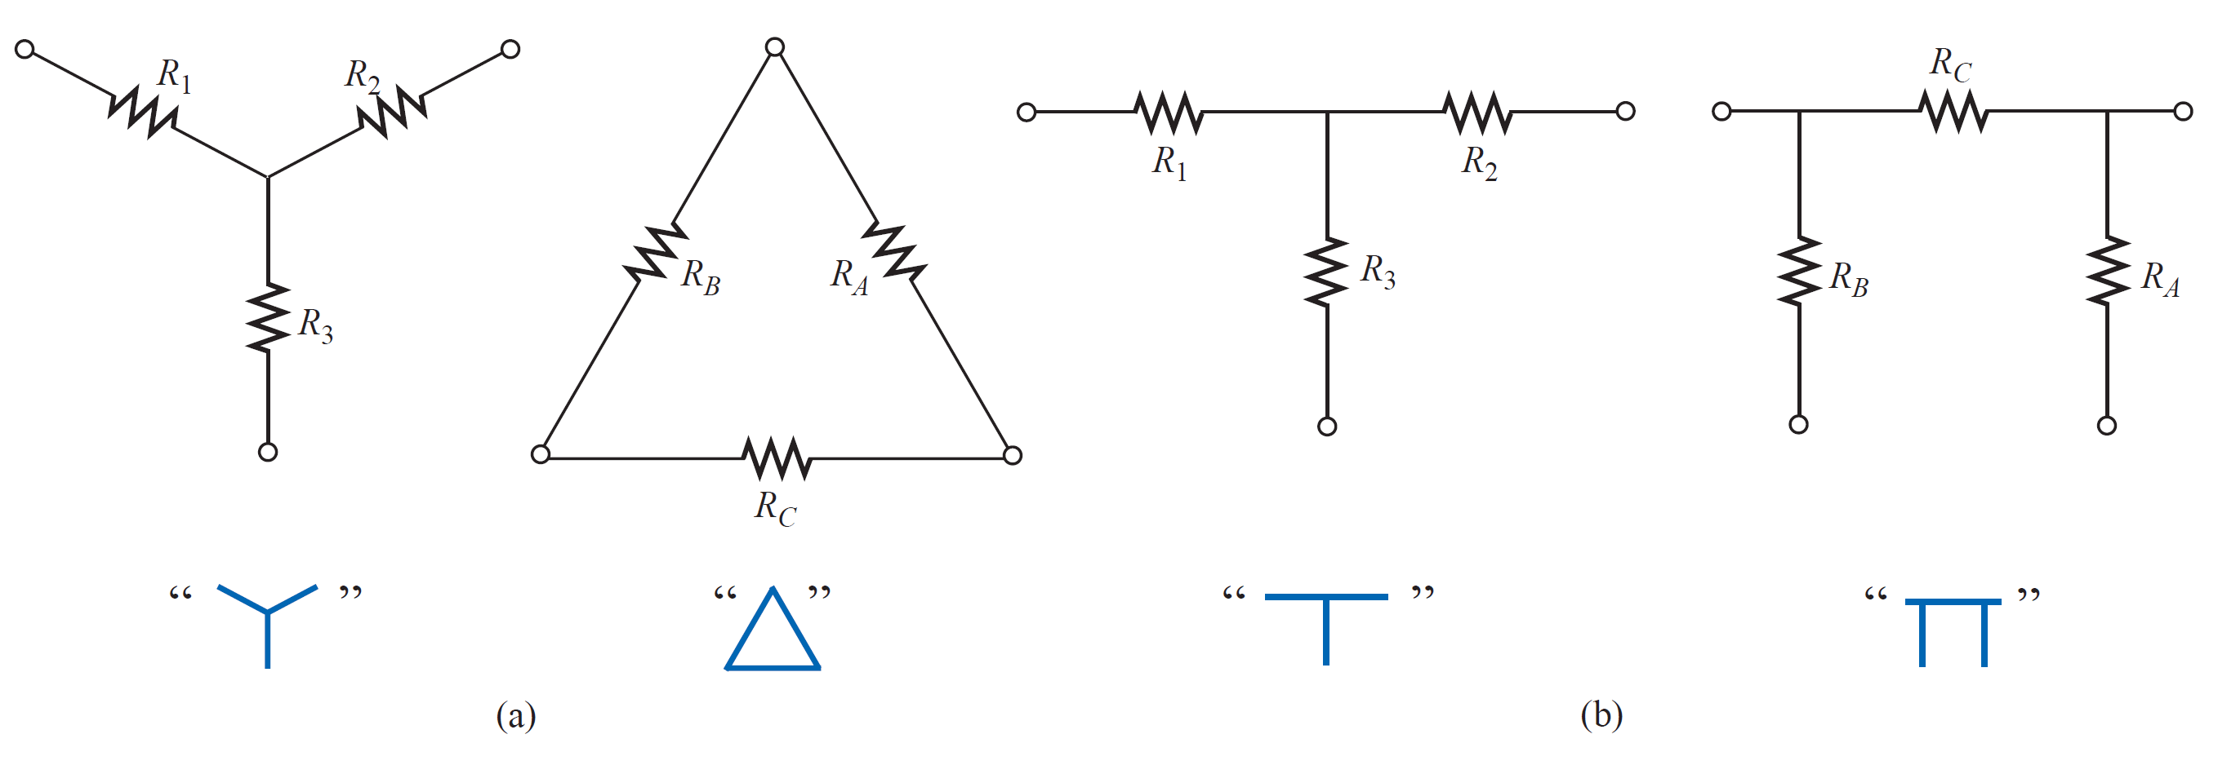
Y- $∆$ (T- $π$) AND $∆$ -Y ($π$ -T) CONVERSIONS

Slide 25
Y- $∆$ (T- $π$) AND $∆$ -Y ($π$ -T) CONVERSIONS

Slide 26
Y- $∆$ (T- $π$) AND $∆$ -Y ($π$ -T) CONVERSIONS

Slide 27
Y- $∆$ (T- $π$) AND $∆$ -Y ($π$ -T) CONVERSIONS

Slide 28
Y- $∆$ (T- $π$) AND $∆$ -Y ($π$ -T) CONVERSIONS

Slide 29
Delta to Wye Conversion

Slide 30
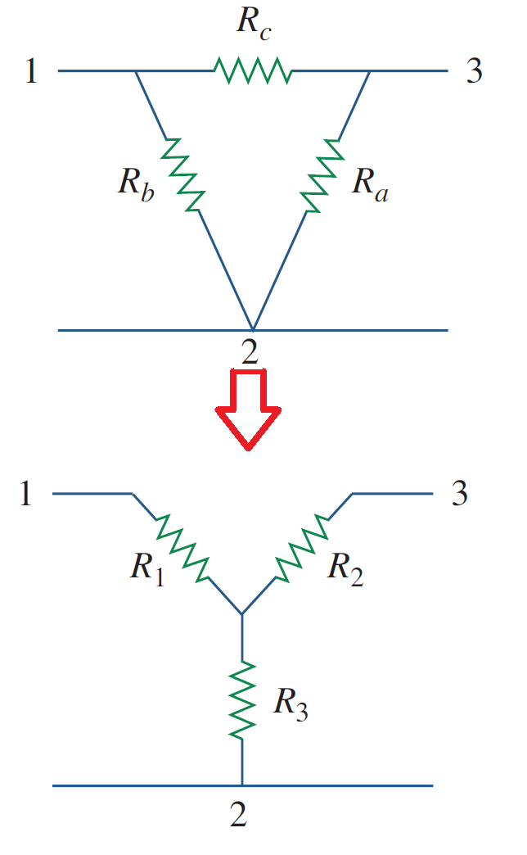
Delta to Wye Conversion

Slide 31
Delta to Wye Conversion

Slide 32
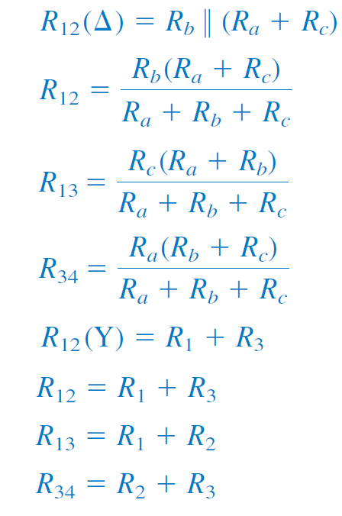
Delta to Wye Conversion

Slide 33
Delta to Wye Conversion

Slide 34
Delta to Wye Conversion

Slide 35
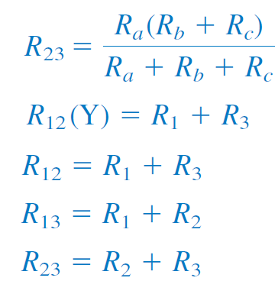
Delta to Wye Conversion

Slide 36
Delta to Wye Conversion

Slide 37
Delta to Wye Conversion

Slide 38
Delta to Wye Conversion

Slide 39
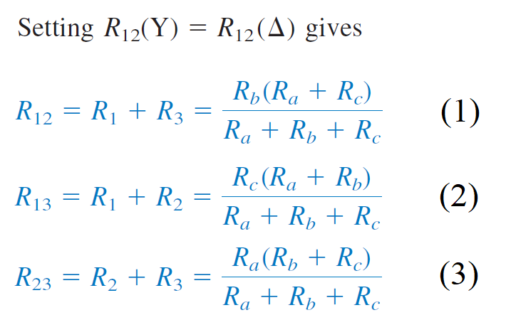
Delta to Wye Conversion

Slide 40
Delta to Wye Conversion

Slide 41
Delta to Wye Conversion

Slide 42
Delta to Wye Conversion
Subtracting Eq. (3) from Eq. (1) and adding the resulting equation to Eq. (1) results in :-

Slide 43
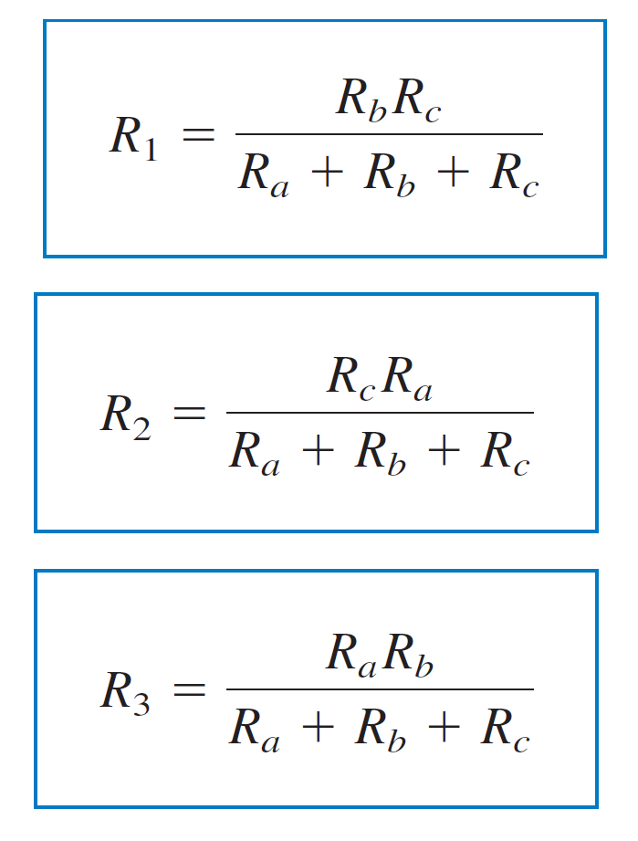
Delta to Wye Conversion
Similarly,
and,

Slide 44
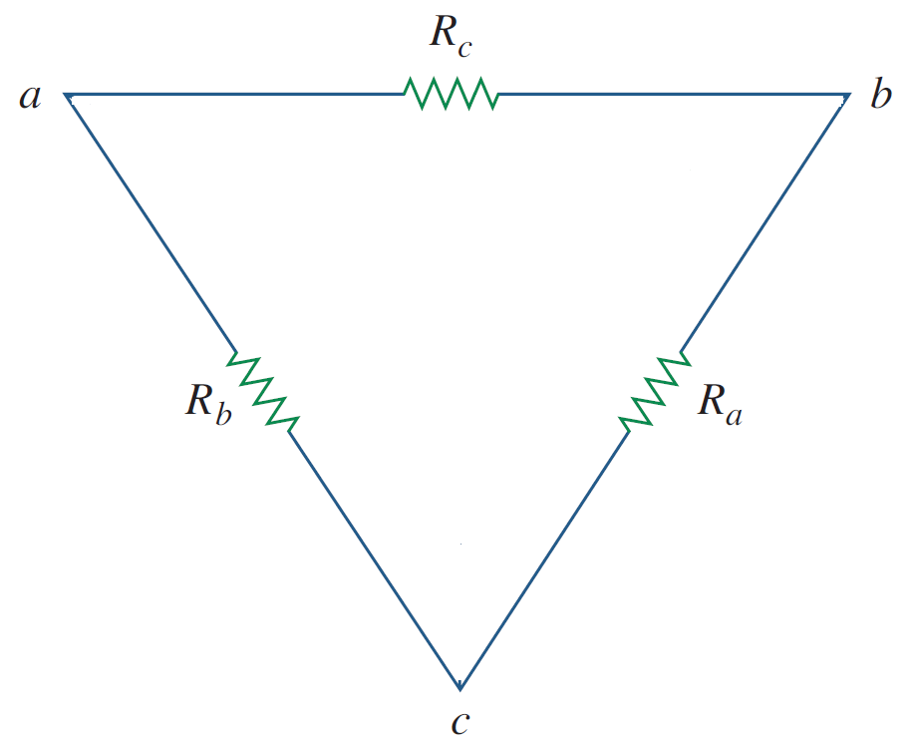
Delta to Wye Conversion
Similarly,
and,

Slide 45
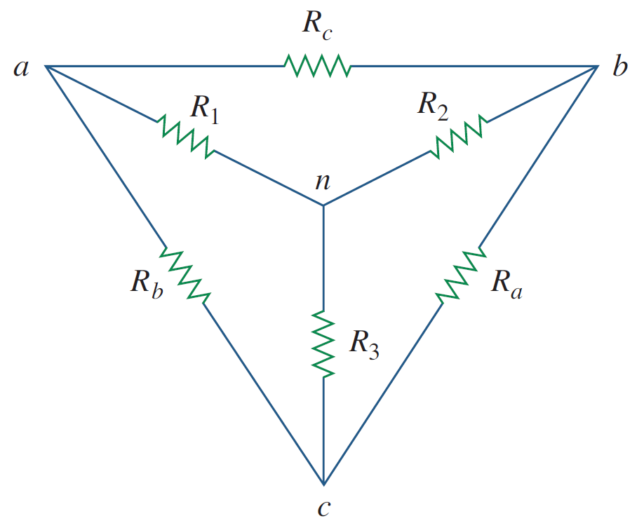
Delta to Wye Conversion
Similarly,
and,

Slide 46
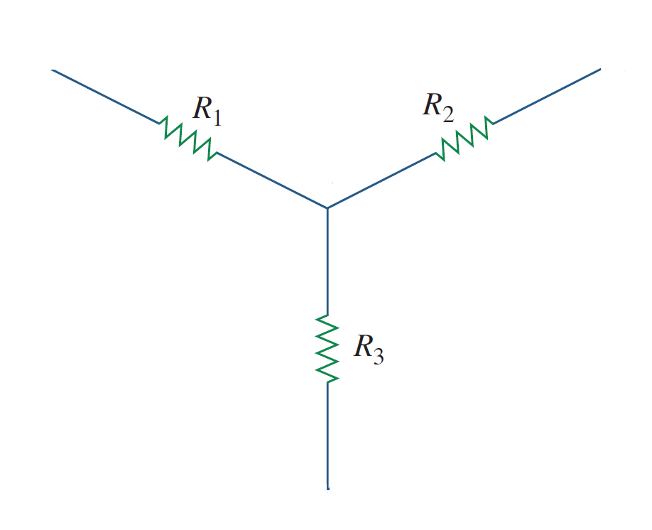
Delta to Wye Conversion
Similarly,
and,

Slide 47
Wye to Delta Conversion

Slide 48
Wye to Delta Conversion

Slide 49
Wye to Delta Conversion

Slide 50
Wye to Delta Conversion

Slide 51
Wye to Delta Conversion
Using the previous sets of equations, then

Slide 52
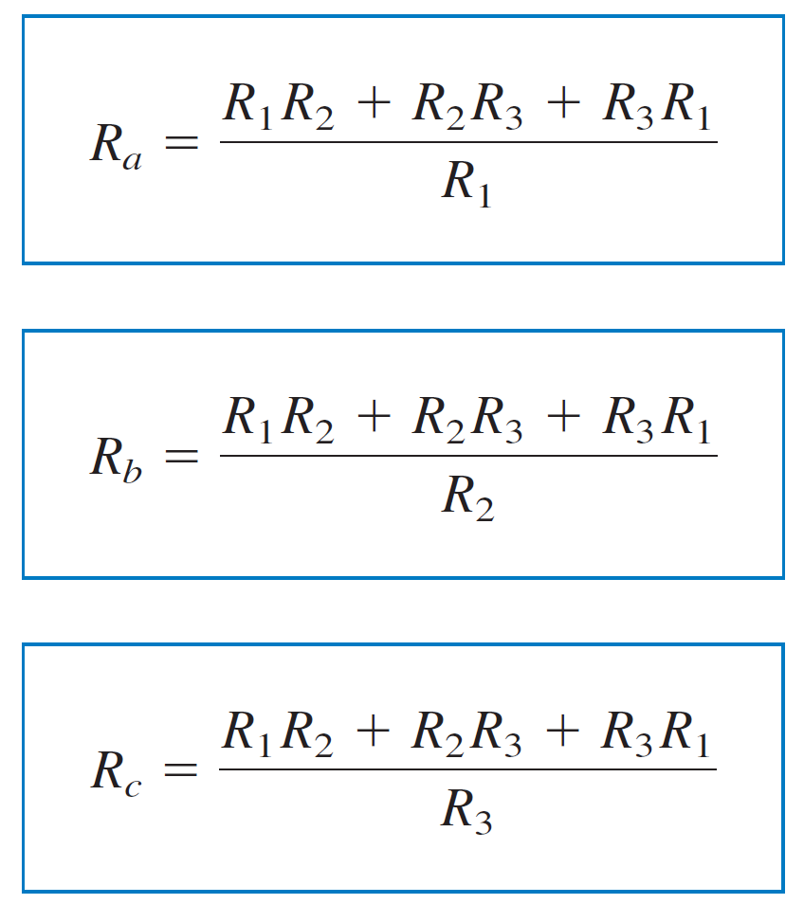
Wye to Delta Conversion
Using the previous sets of equations, then

Slide 53
Wye to Delta Conversion

Slide 54
Wye to Delta Conversion

Slide 55
Wye to Delta Conversion

Slide 56

Y- $∆$ AND $∆$ -Y CONVERSIONS
The Y and $∆$networks are said to be balanced when

Slide 57

Y- $∆$ AND $∆$ -Y CONVERSIONS
The Y and $∆$networks are said to be balanced when

Slide 58
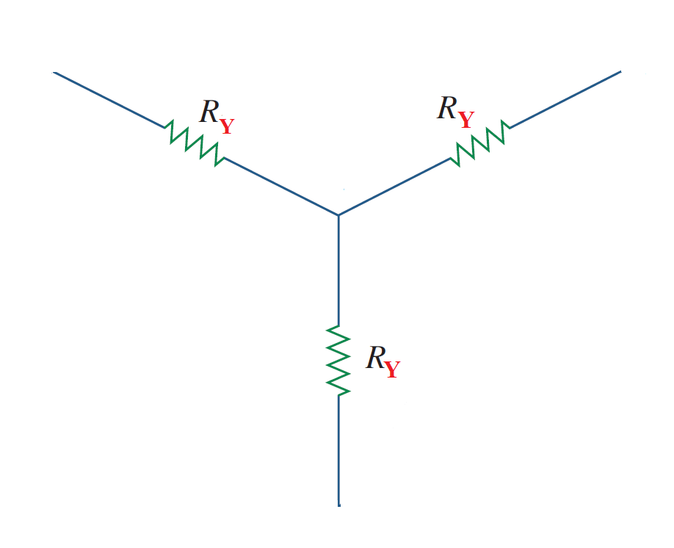
Y- $∆$ AND $∆$ -Y CONVERSIONS
The Y and $∆$networks are said to be balanced when

Slide 59

Y- $∆$ AND $∆$ -Y CONVERSIONS
The Y and $∆$networks are said to be balanced when

Slide 60
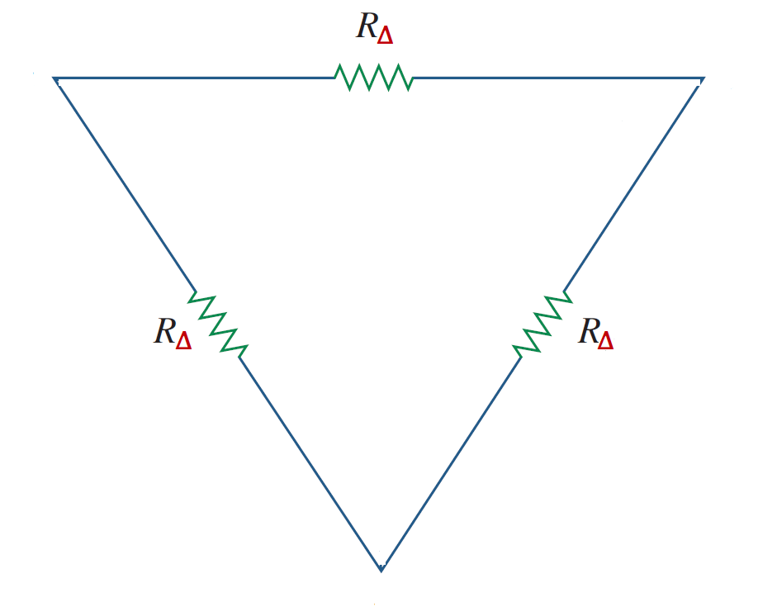
Y- $∆$ AND $∆$ -Y CONVERSIONS
The Y and $∆$networks are said to be balanced when

Slide 61
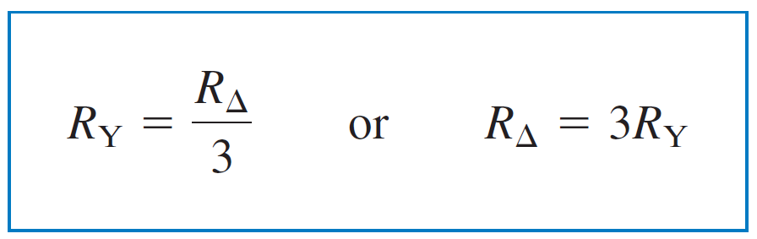
Y- $∆$ AND $∆$ -Y CONVERSIONS
The Y and $∆$networks are said to be balanced when
Under these conditions, conversion formulas become

Slide 62
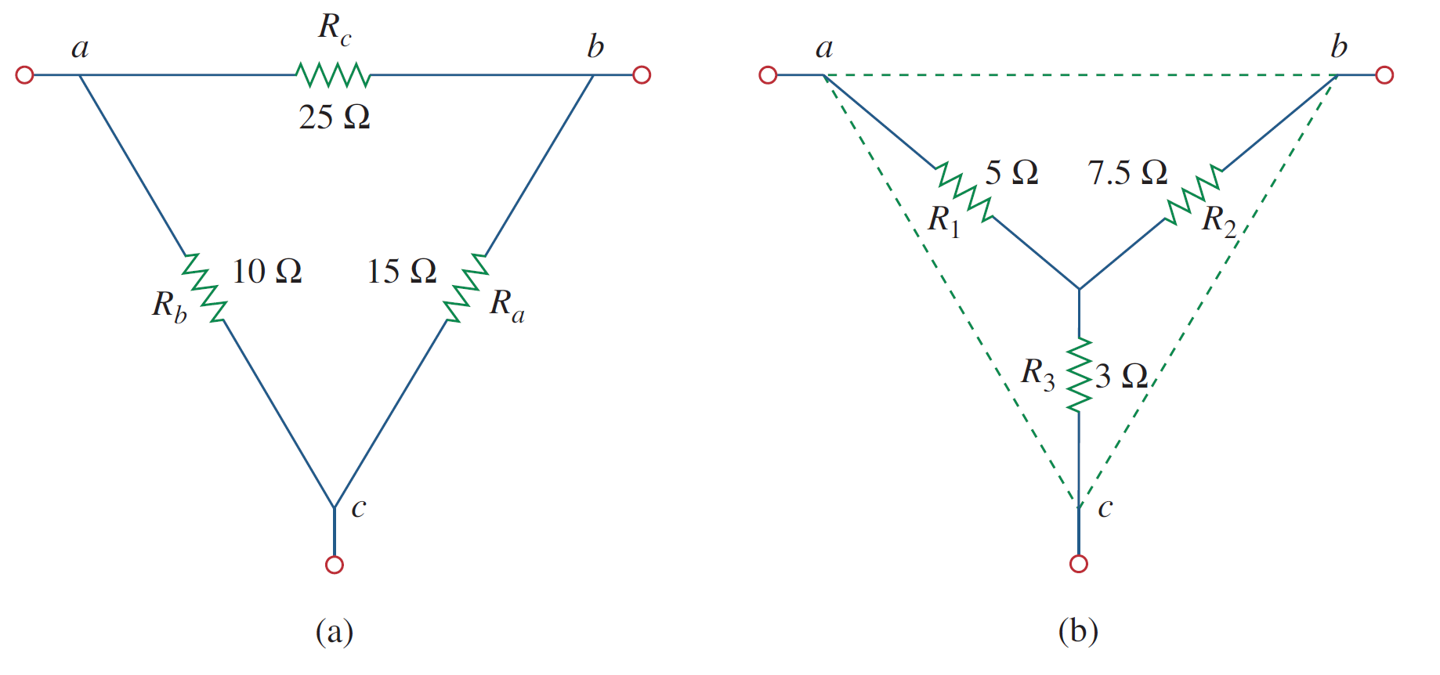
Y- $∆$ AND $∆$ -Y CONVERSIONS
Example Convert the $∆$ network in Figure shown to an equivalent Y network.

Slide 63
Y- $∆$ AND $∆$ -Y CONVERSIONS
Example Convert the $∆$ network in Figure shown to an equivalent Y network.

Slide 64
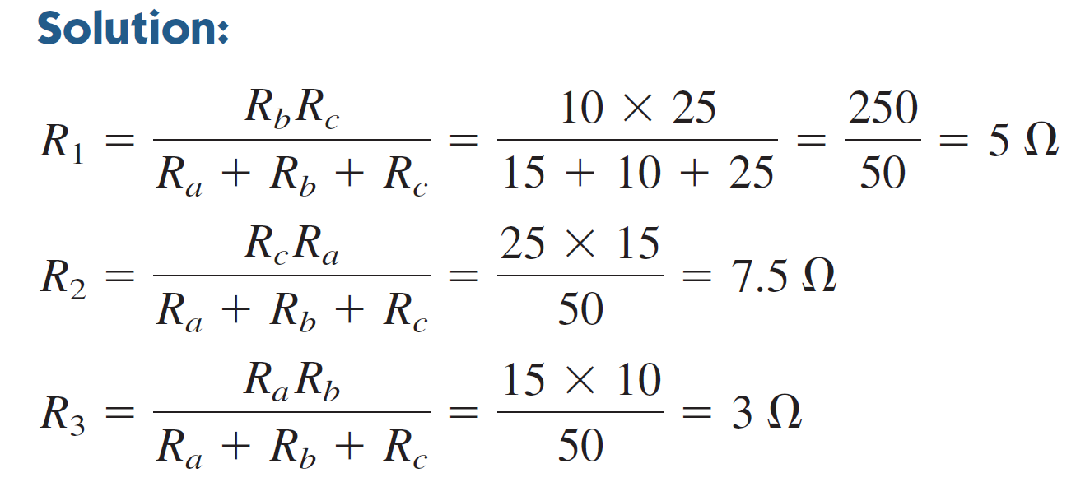
Y- $∆$ AND $∆$ -Y CONVERSIONS
Example Convert the $∆$ network in Figure shown to an equivalent Y network.

Slide 65
Y- $∆$ AND $∆$ -Y CONVERSIONS
Example Convert the $∆$ network in Figure shown to an equivalent Y network.

Slide 66
Y- $∆$ AND $∆$ -Y CONVERSIONS
Example Convert the $∆$ network in Figure shown to an equivalent Y network.

Slide 67
Y- $∆$ AND $∆$ -Y CONVERSIONS
Example Convert the $∆$ network in Figure shown to an equivalent Y network.

Slide 68
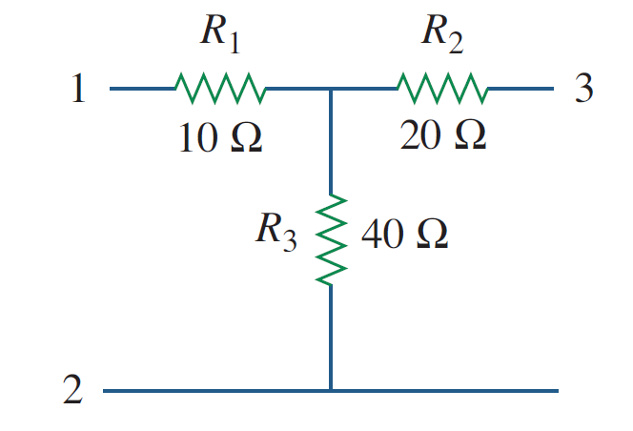
Y- $∆$ AND $∆$ -Y CONVERSIONS
Example Transform the wye network in Figure shown to a delta network.

Slide 69
Y- $∆$ AND $∆$ -Y CONVERSIONS
Example Transform the wye network in Figure shown to a delta network.

Slide 70
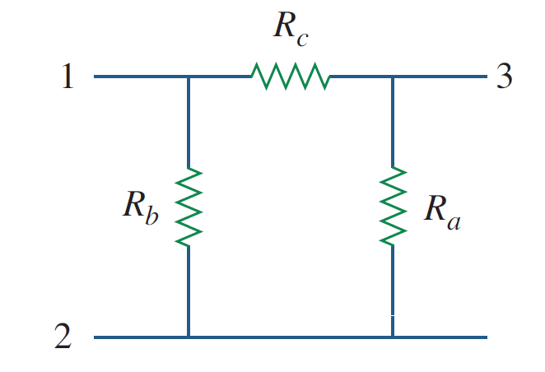
Y- $∆$ AND $∆$ -Y CONVERSIONS
Example Transform the wye network in Figure shown to a delta network.

Slide 71


Y- $∆$ AND $∆$ -Y CONVERSIONS
Example Transform the wye network in Figure shown to a delta network.
Solution:-
$$R_{a}=\frac{R_{1}R_{2}+R_{2}R_{3}+R_{3}R_{1}}{R_{1}}$$
$$R_{b}=\frac{R_{1}R_{2}+R_{2}R_{3}+R_{3}R_{1}}{R_{2}}$$
$$R_{c}=\frac{R_{1}R_{2}+R_{2}R_{3}+R_{3}R_{1}}{R_{3}}$$

Slide 72


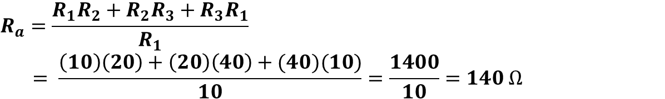
Y- $∆$ AND $∆$ -Y CONVERSIONS
Example Transform the wye network in Figure shown to a delta network.
Solution:-
$$R_{a}=\frac{R_{1}R_{2}+R_{2}R_{3}+R_{3}R_{1}}{R_{1}}$$
$$= \frac{\left(10\right)\left(20\right)+\left(20\right)\left(40\right)+(40)(10)}{10}=\frac{1400}{10}=140 Ω$$
$$R_{b}=\frac{R_{1}R_{2}+R_{2}R_{3}+R_{3}R_{1}}{R_{2}}$$
$$R_{c}=\frac{R_{1}R_{2}+R_{2}R_{3}+R_{3}R_{1}}{R_{3}}$$
140 Ω

Slide 73

Y- $∆$ AND $∆$ -Y CONVERSIONS
Example Transform the wye network in Figure shown to a delta network.
Solution:-
$$R_{a}=\frac{R_{1}R_{2}+R_{2}R_{3}+R_{3}R_{1}}{R_{1}}$$
$$= \frac{\left(10\right)\left(20\right)+\left(20\right)\left(40\right)+(40)(10)}{10}=\frac{1400}{10}=140 Ω$$
$$R_{b}=\frac{R_{1}R_{2}+R_{2}R_{3}+R_{3}R_{1}}{R_{2}}=\frac{1400}{20}=70 Ω$$
$$R_{c}=\frac{R_{1}R_{2}+R_{2}R_{3}+R_{3}R_{1}}{R_{3}}$$
140 Ω
70 Ω

Slide 74

Y- $∆$ AND $∆$ -Y CONVERSIONS
Example Transform the wye network in Figure shown to a delta network.
Solution:-
$$R_{a}=\frac{R_{1}R_{2}+R_{2}R_{3}+R_{3}R_{1}}{R_{1}}$$
$$= \frac{\left(10\right)\left(20\right)+\left(20\right)\left(40\right)+(40)(10)}{10}=\frac{1400}{10}=140 Ω$$
$$R_{b}=\frac{R_{1}R_{2}+R_{2}R_{3}+R_{3}R_{1}}{R_{2}}=\frac{1400}{20}=70 Ω$$
35 Ω
$$R_{c}=\frac{R_{1}R_{2}+R_{2}R_{3}+R_{3}R_{1}}{R_{3}}=\frac{1400}{40}=35 Ω$$
140 Ω
70 Ω

Slide 75
References
Boylestad, Robert L. Introductory circuit analysis. Pearson Education, 2010.
Robbins, Allan H., and Wilhelm C. Miller. Circuit analysis: Theory and practice. Cengage Learning, 2012.
Sadiku, Matthew NO, and Chales K. Alexander. Fundamentals of electric circuits. McGraw-Hill Higher Education, 2007.

